Slide 1
Encryption Protocols

Slide 2
Key Encryption (1 of 2)
A key is a random string of characters woven into original data’s bits
It generates unique data block called ciphertext
The key is created according to a specific set of rules (algorithms)
Key encryption can be separated into two categories:
Private key encryption
Public key encryption

Slide 3
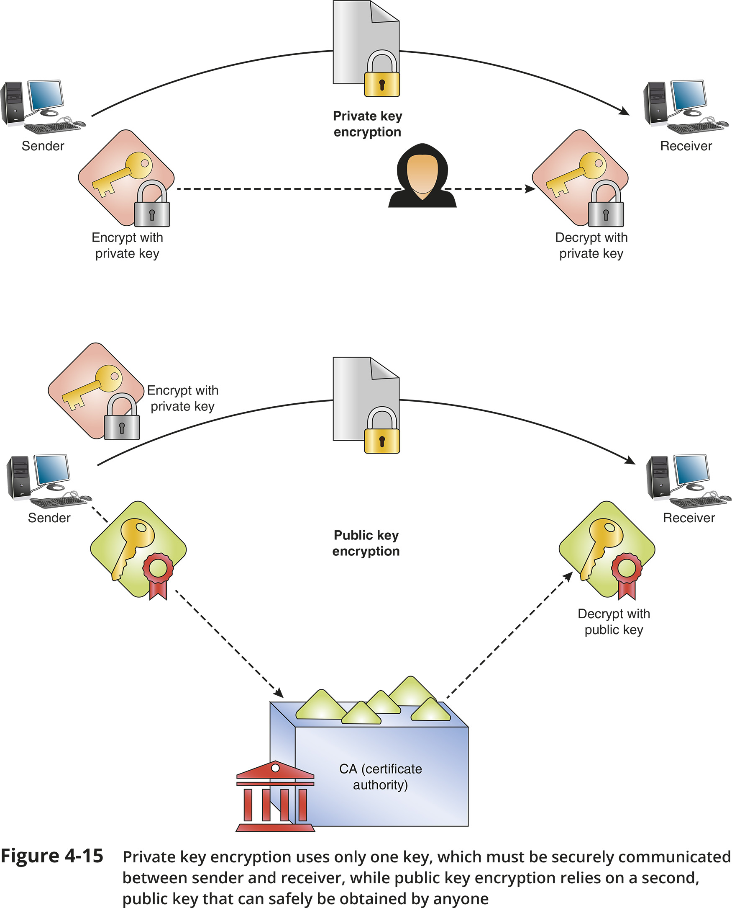
Key Encryption (2 of 2)

Slide 4
IPsec (Internet Protocol Security)
IPsec is an encryption protocol suite that defines rules for encryption, authentication, and key management for TCP/IP transmissions
IPsec creates secure connections in five steps:
1. IPsec initiation
2. Key management
3. Security negotiations
4. Data transfer
5. Termination
Operates in two modes:
Transport mode
Tunnel mode

Slide 5
SSL (Secure Sockets Layer) and TLS (Transport Layer Security)
Both SSL and TLS are methods of encrypting TCP/IP transmissions
Both protocols work side by side and are widely known as SSL/TLS or TLS/SSL
When a client and server establish an SSL/TLS connection, they establish a unique session which is an association between client and server
The session is defined by an agreement on a specific set of encryption techniques
A session is created by an SSL handshake protocol
The handshake protocol allows client and server to authenticate
This handshake is similar to a TCP three-way handshake

